Slide 1
IEEE UA Branch
Done by : Mariam hani khalife
Course : Web design
To: Dr. Anthony Tannoury

Slide 2
Table of contents
01
02
03
04
Introduction
Screenshots
Content of the Web
Expectation

Slide 3

01
Introduction

Slide 4
Introduction
The problem to solve:
The goal
Many students don’t fully realize the value of being part of IEEE, which leads to low participation and missed opportunities.
We plan to create a freindly , informative website that clearly shows the benefits of the IEEE membership ,the past and the upcoming events and how to register to be part of this community .

Slide 5
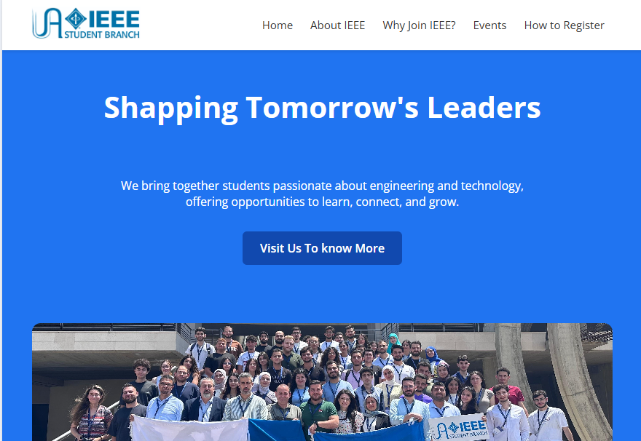
The screenshots of the Web :

Slide 6
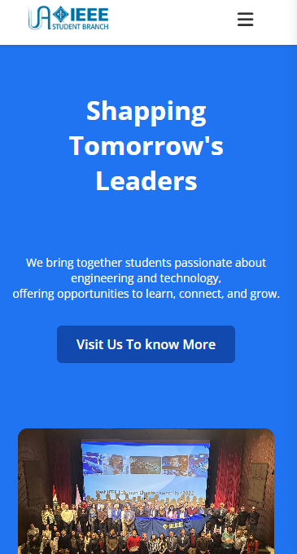
Respnsivness
The website is responsive on all users devices(computers ,tablets ,phones, small phones)

Slide 7


Slide 8

Content of the Web:

Slide 9
Home page:
Why us page:
Registration page:
Contains past events with photos, upcoming events shown in a calendar with short details, and a brief section about IEEE.
Shows the benefits of IEEE membership, with examples and useful links.
Provides step-by-step instructions for registering, plus all available payment options.

Slide 10
14 $
per year

Slide 11
over 440 members
113 members
30 members
AUB University
LAU University
Antonine University

Slide 12

The expectations :
After these clarifications, which are presented very clearly and in detail on the informative website, we can expect an increase in both new memberships and membership renewals.

Slide 13
Resources
Photos:
https://www.comsoc.org/membership
https://ieeecanada.org/new-members/
https://is1-ssl.mzstatic.com/image/thumb/Purple118/v4/c4/21/bc/c421bc7e-5389-0c7b-5aef-5ae40de39c4f/pr_source.jpg/750x750bb.jpeg

Slide 14
Thanks !
Do you have any questions?

